Slide 1
Session 03
Networking Media
Subject : Z1451 / Jaringan Komputer Year : 2015

Slide 2
References
Main Reference Session 03 : Forouzan, B.A., (2010). Data Communications and Networking, 4th Edition, Mc.Graw-Hill Chapter 7

Slide 3
Learning Outcomes
Students will be able to explain and use Wired & Wireless LAN for corporate network

Slide 4
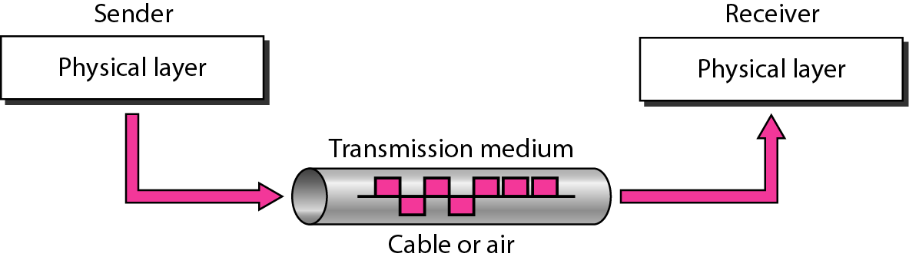
Figure 7.1 Transmission medium and physical layer
Forouzan, B.A., (2010). Data Communications and Networking, 4th Edition, Mc.Graw-Hill, Chapter 7

Slide 5
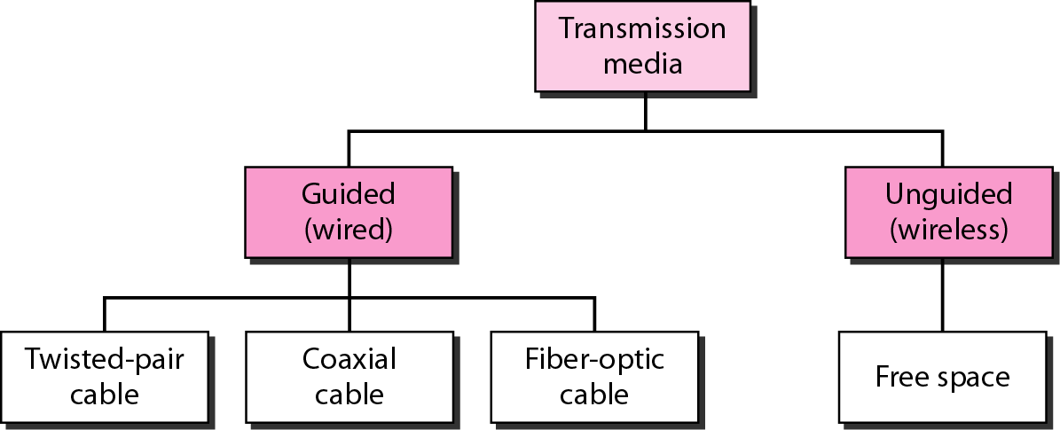
Figure 7.2 Classes of transmission media
Forouzan, B.A., (2010). Data Communications and Networking, 4th Edition, Mc.Graw-Hill, Chapter 7

Slide 6
7-1 GUIDED MEDIA
Guided media, which are those that provide a conduit from one device to another, include twisted-pair cable, coaxial cable, and fiber-optic cable.
Topics discussed in this section:
Twisted-Pair Cable Coaxial Cable Fiber-Optic Cable
Forouzan, B.A., (2010). Data Communications and Networking, 4th Edition, Mc.Graw-Hill, Chapter 7

Slide 7

Figure 7.3 Twisted-pair cable
Forouzan, B.A., (2010). Data Communications and Networking, 4th Edition, Mc.Graw-Hill, Chapter 7

Slide 8
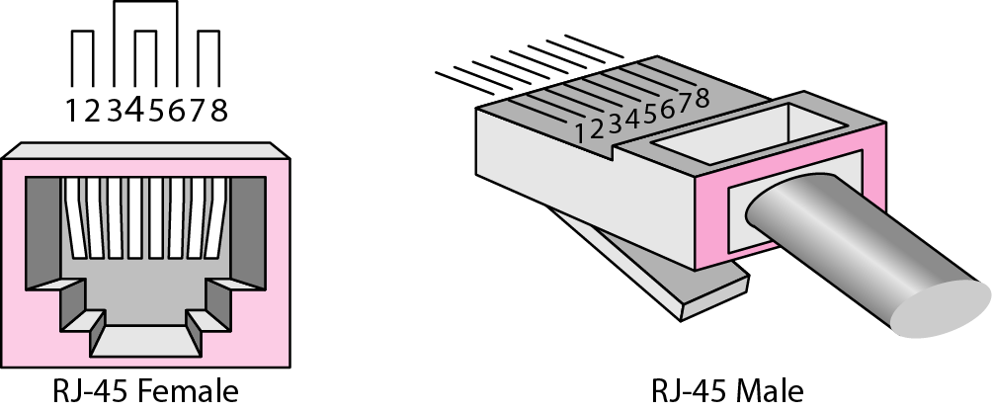
Figure 7.5 UTP connector
Forouzan, B.A., (2010). Data Communications and Networking, 4th Edition, Mc.Graw-Hill, Chapter 7

Slide 9
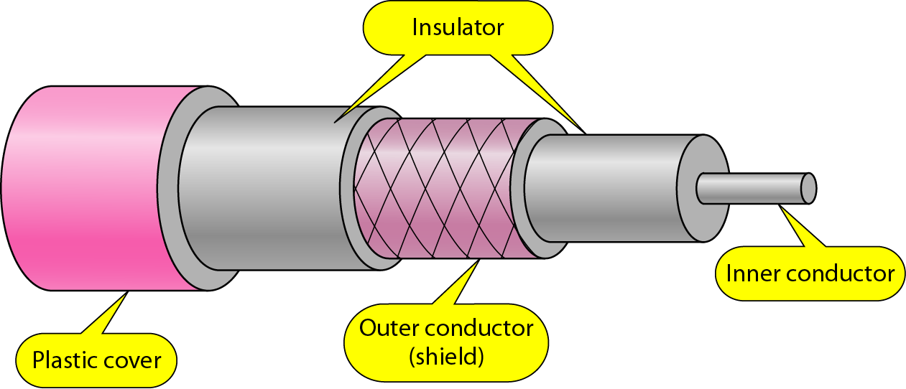
Figure 7.7 Coaxial cable
Forouzan, B.A., (2010). Data Communications and Networking, 4th Edition, Mc.Graw-Hill, Chapter 7

Slide 10
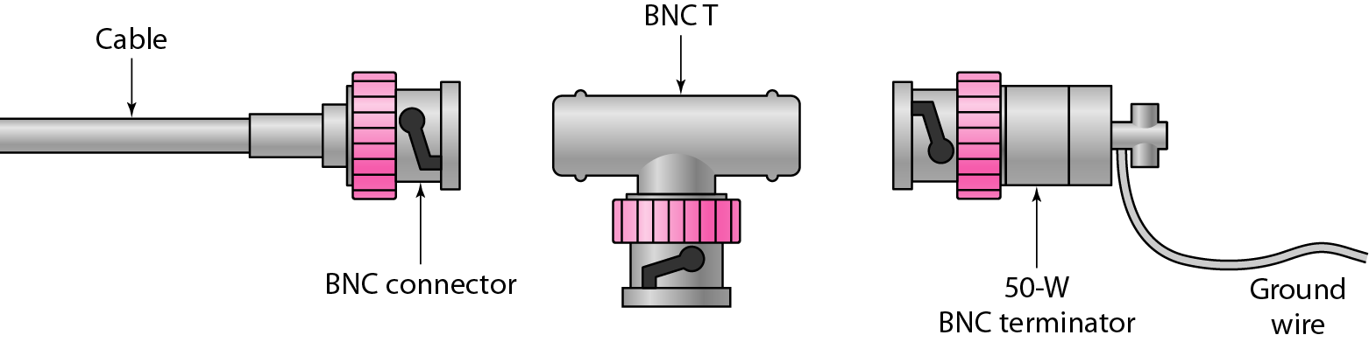
Figure 7.8 BNC connectors
Forouzan, B.A., (2010). Data Communications and Networking, 4th Edition, Mc.Graw-Hill, Chapter 7

Slide 11
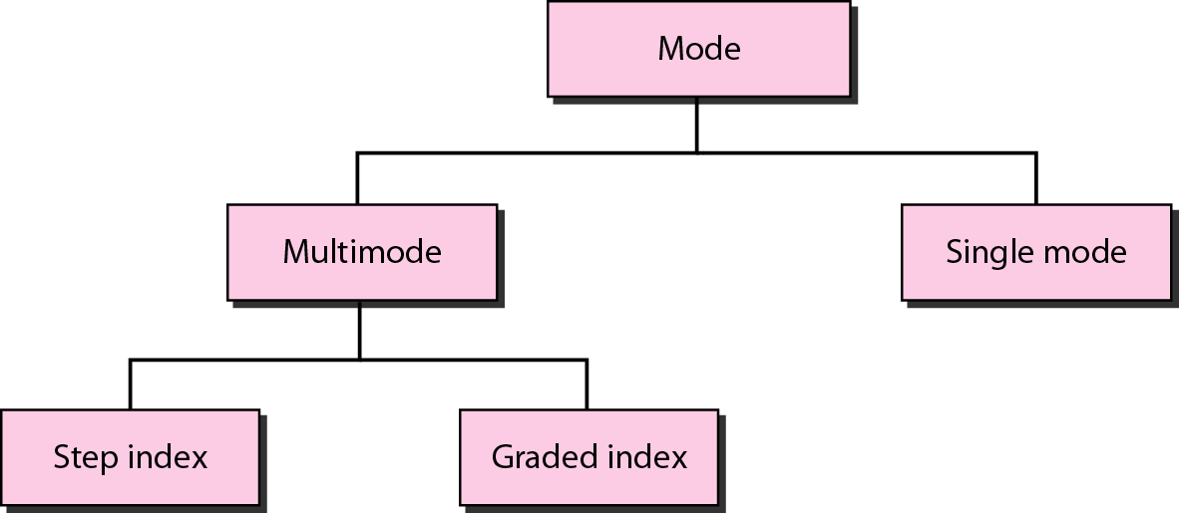
Figure 7.12 Propagation modes
Forouzan, B.A., (2010). Data Communications and Networking, 4th Edition, Mc.Graw-Hill, Chapter 7

Slide 12
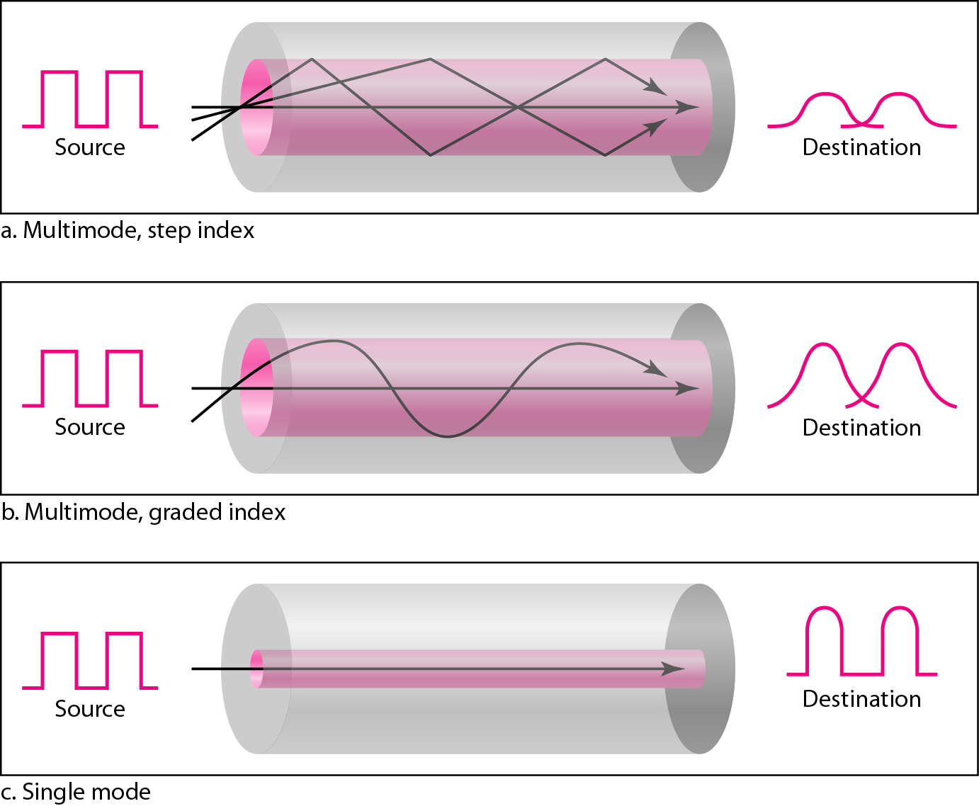
Figure 7.13 Modes
Forouzan, B.A., (2010). Data Communications and Networking, 4th Edition, Mc.Graw-Hill, Chapter 7

Slide 13
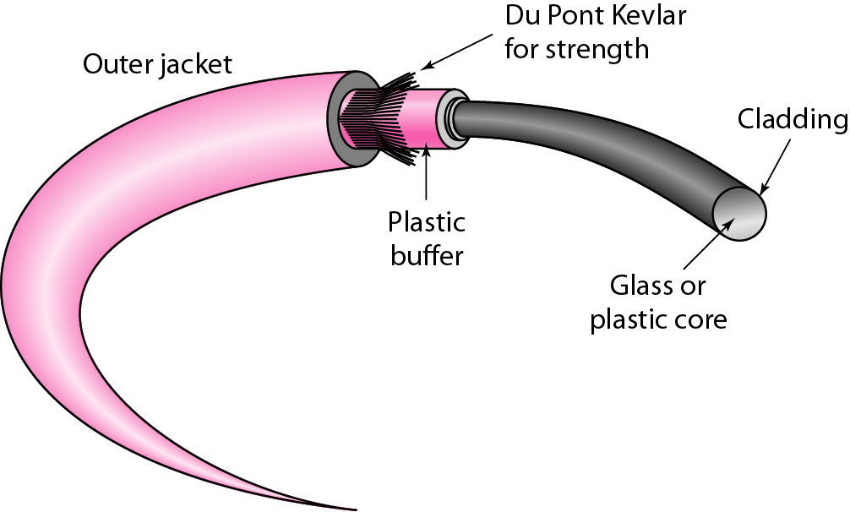
Figure 7.14 Fiber construction
Forouzan, B.A., (2010). Data Communications and Networking, 4th Edition, Mc.Graw-Hill, Chapter 7

Slide 14
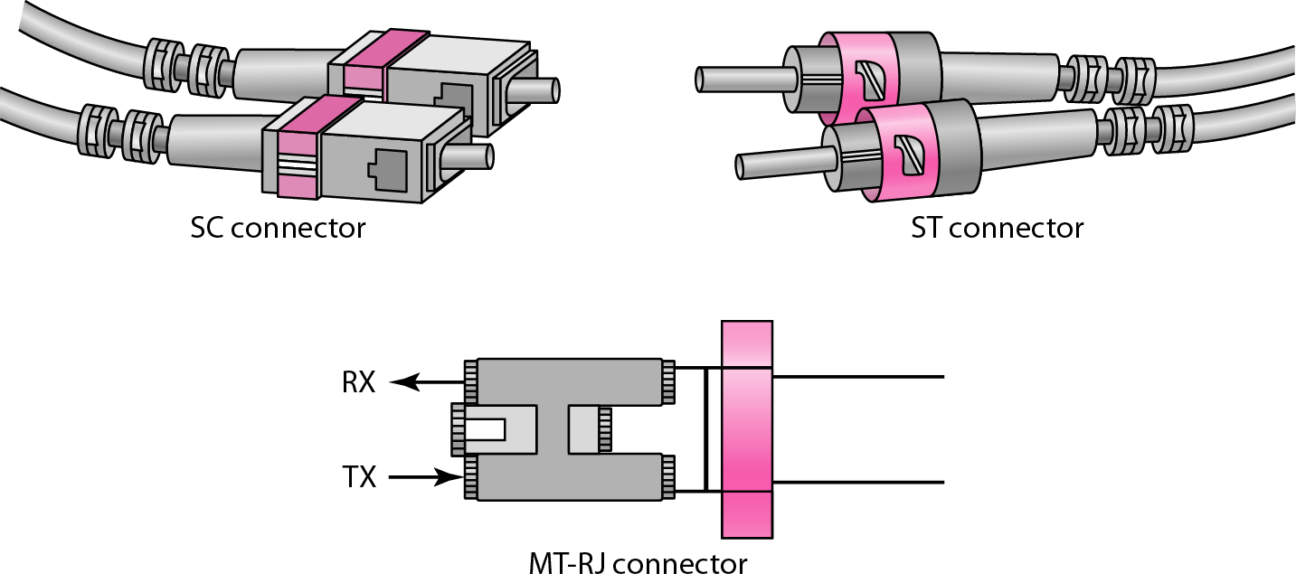
Figure 7.15 Fiber-optic cable connectors
Forouzan, B.A., (2010). Data Communications and Networking, 4th Edition, Mc.Graw-Hill, Chapter 7

Slide 15
Transmission Media
Bounded/Guided
Copper Cable such as Twisted Pair (Unshielded, Shielded) and Coaxial Cable
Optical Cable (Single mode and Multi mode)
Unbounded/Unguided
Electromagnetic Wave (VHF, UHF, Microwave).

Slide 16
Transmission Characteristics
Characteristics and data transmission is determined by the medium used and signal quality
Data transmission using guided media, the medium itself determine the bandwidth of the communication channel capacity.
Data transmission using electromagnetic wave the bandwidth of antenna is important.
Key performance is the transmission data rate and the covered distance.

Slide 17
Media Access Control
Shared-media broadcast technology.
Ethernet’s MAC performs three functions:
Transmitting and receiving data packets .
Decoding data packets and checking them for valid addresses before passing them to the upper layers.
Detecting errors within data packets or on the network
Use Contention Transmission principle (First come, first served ).
Dictates who can transmit and when (Only one station may transmit at a time; otherwise, their signals would be scrambled)

Slide 18
Media Access Control
Assembly of data into frame with address and error detection fields
Disassembly of frame
Address recognition
Error detection
Govern access to transmission medium
Not found in traditional layer 2 data link control
For the same LLC, several MAC options may be available

Slide 19
Ethernet
Most popular LAN standards
Simple and relatively inexpensive
Scalable
10 Mbps, 100 Mbps, 1 Gbps
Physical Layer
Bus (broadcast) topology
10Base-T: Manchester encoding
100Base-T: 4B/5B encoding
8-wire (4-pair) UTP bundle

Slide 20
Logical Link Control
Interface to higher levels
Flow and error control
Transmission of link level PDUs between two stations
Must support multiaccess, shared medium
Relieved of some link access details by MAC layer
Addressing involves specifying source and destination LLC users
Referred to as service access points (SAP)
Typically higher level protocol

Slide 21
Wireless LAN Specifications
802.11b+
802.11b
802.11g
802.11a
Data Transfer Rate
Up to 22Mbps
Up to 11Mbps
Up to 54Mbps
Up to 54Mbps
Frequency
2.4GHz
2.4GHz
2.4GHz
5GHz
Compatibiliy
802.11b
802.11g
802.11b
802.11a only

Slide 22
802.11b Wireless LAN
Utilise Direct Sequence Spread Spectrum (DSSS) technology
Carrier Sense Multiple Access with Collision Avoidance (CSMA/CA)
Frequency range of DSSS is between 2.4 to 2.4835 GHz
No. of channels at different part of the world varies (S.E.A. : 13 channels)
Each channel bandwidth is approximately 20MHz

Slide 23
3-2 WIRELESS LANS
Wireless communication is one of the fastest growing technologies. The demand for connecting devices without the use of cables is increasing everywhere. Wireless LANs can be found on college campuses, in office buildings, and in many public areas. In this section, we concentrate on two wireless technologies for LANs: IEEE 802.11 wireless LANs, sometimes called wireless Ethernet, and Bluetooth, a technology for small wireless LANs.
Forouzan, B.A., (2010). TCP/IP Protocol Suite, 4th Edition, Mc.Graw-Hill

Slide 24
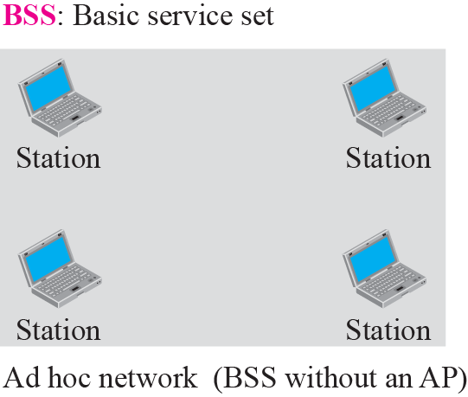
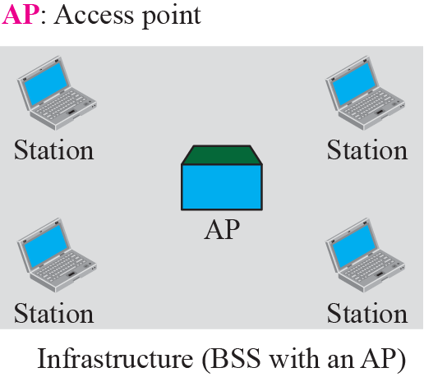
Figure 3.13 Basic service sets (BSSs)
also known as “peer-to-peer” mode
Forouzan, B.A., (2010). TCP/IP Protocol Suite, 4th Edition, Mc.Graw-Hill

Slide 25
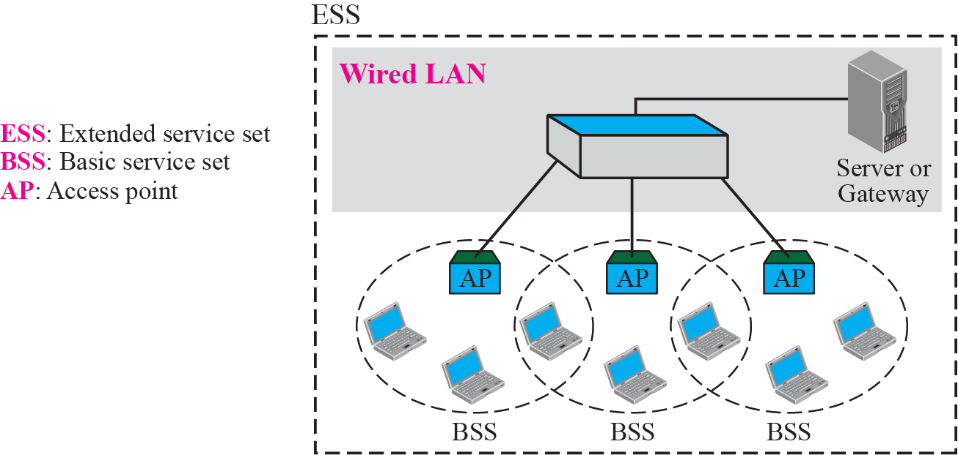
Figure 3.14 Extended service sets (ESSs)
Forouzan, B.A., (2010). TCP/IP Protocol Suite, 4th Edition, Mc.Graw-Hill

